Slide 1




Leveraging Large Language Models and FHIR Standards to Bridge the Health Literacy Gap in Kenya (St. Joseph Hospital)
Kathrine Ganda, Terry Mochire, Dr. Dorah Rioba, Steven Wanyee
IntelliSOFT Consulting Limited
Technological Advancements in Public health
Kenya Health Security Convention | 5th – 8th May 2026 | Mombasa - Kenya

Slide 2
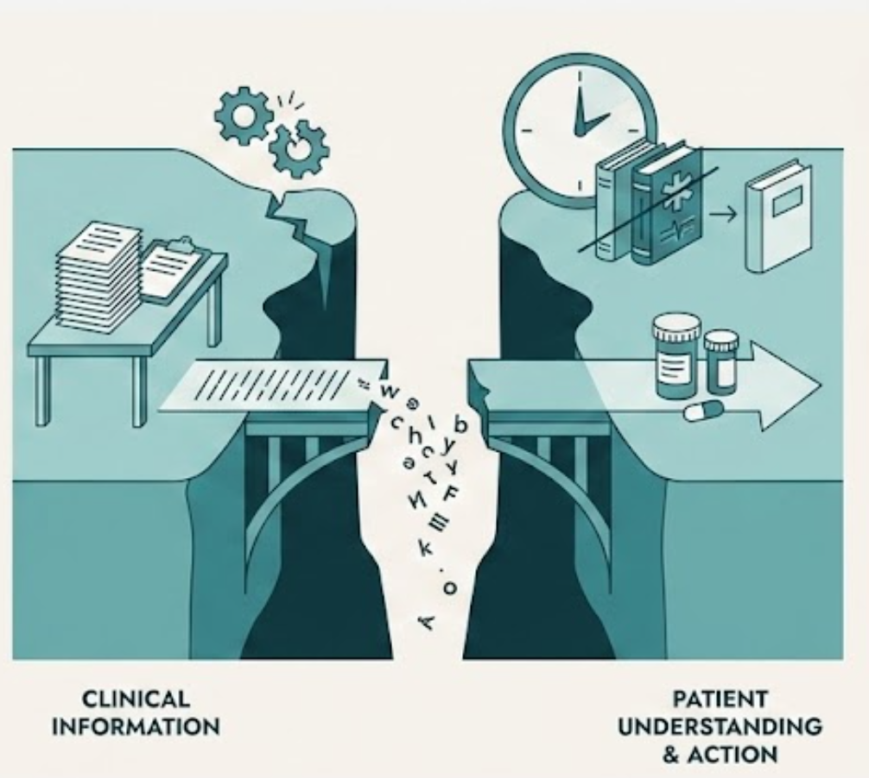
Background
In Kenya, low health literacy and insufficient patient engagement across the continuum of care continue to undermine individuals’ ability to understand and act on health information.
This gap was particularly evident at St.Joseph Health Center Kenya, where quantitative and qualitative data persistently demonstrated this gap.
Implications: Poorer adherence to treatment and follow-up plans, reduced patient participation in care,a diminished ability of patients to participate actively in their own care, and an added burden on clinicians.
Notes:
At St. Joseph Health Centre and facilities like it, patients routinely exit consultations confused about their diagnosis, uncertain about medication instructions, and unaware of necessary follow-up steps. This is not a failure of clinical care — it is a failure of communication.
Several compounding factors drive this gap:
Language and Literacy Barriers Communities served by public health facilities often include patients with varied literacy levels and highly localised language preferences. Standard written instructions and verbal explanations during rushed consultations fail to reach these patients meaningfully.
Medical Jargon Clinical documentation — diagnosis codes, pharmaceutical names, lab terminology — is designed for providers, not patients. Without translation into plain language, it is effectively invisible to the people it concerns most.
No Continuity Beyond the Consultation Once a patient leaves the facility, there is typically no mechanism to reinforce what was discussed, answer follow-up questions, or flag warning signs. This absence of post-visit support creates a dangerous gap in care continuity.
The Consequence Non-adherence to medication, avoidable complications, preventable return visits, and diminished patient trust in the health system — all driven by a problem that is solvable.
Globally, 40-80% of medical information provided by healthcare practitioners is forgotten immediately, indicating a significant issue with patient recall of key instructions. This is compounded by literacy gaps in SSA–where more than 1 in 3 adults remain illeterate.

Slide 3

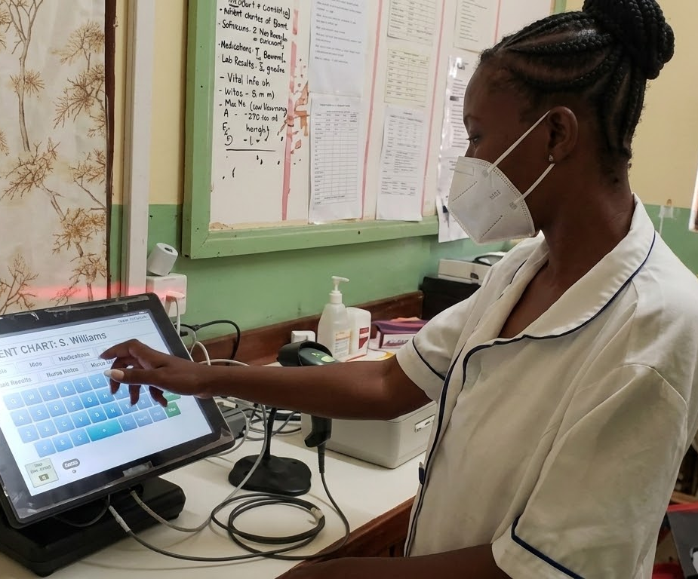
Proposed SolutionosPPed Solution
IntelliSOFT’s proposed response to this gap was to design and integrate a custom, extendable service module within the OpenMRS 3.x platform, linking St. Joseph’s hospital’s EMR with AI and messaging services. The solution would:
summarize
Generate personalized health summaries tailored to individual literacy levels.
psychology
Enable patients to better understand care and make informed decisions.
task_alt
Reduce clinician time spent on repeated explanation and clarification of care information.
Notes:
At St. Joseph Health Centre and facilities like it, patients routinely exit consultations confused about their diagnosis, uncertain about medication instructions, and unaware of necessary follow-up steps. This is not a failure of clinical care — it is a failure of communication.
Several compounding factors drive this gap:
Language and Literacy Barriers Communities served by public health facilities often include patients with varied literacy levels and highly localised language preferences. Standard written instructions and verbal explanations during rushed consultations fail to reach these patients meaningfully.
Medical Jargon Clinical documentation — diagnosis codes, pharmaceutical names, lab terminology — is designed for providers, not patients. Without translation into plain language, it is effectively invisible to the people it concerns most.
No Continuity Beyond the Consultation Once a patient leaves the facility, there is typically no mechanism to reinforce what was discussed, answer follow-up questions, or flag warning signs. This absence of post-visit support creates a dangerous gap in care continuity.
The Consequence Non-adherence to medication, avoidable complications, preventable return visits, and diminished patient trust in the health system — all driven by a problem that is solvable.
Globally, 40-80% of medical information provided by healthcare practitioners is forgotten immediately, indicating a significant issue with patient recall of key instructions. This is compounded by literacy gaps in SSA–where more than 1 in 3 adults remain illeterate.

Slide 4
Objectives
01
To involve patients more meaningfully and actively in the continuum of care by improving how health information is communicated after consultation.
02
To improve patient understanding of diagnosis, medication use, follow-up actions, and self-care instructions.
03
To reduce clinician time spent on repeated explanation and clarification of care information.
04
To support full deployment and validation of the solution at St. Joseph Hospital in a real-world care setting.
05
To generate operational evidence and implementation learning to inform future scale-up beyond St. Joseph Hospital.

Slide 5
Methodology
Study Design & Setting
A prospective observational study at St. Joseph Health Centre (SJH) outpatient department.
800 patients and 10 clinicians.
Pilot run for 18 months.
Sampling & Eligibility
Inclusion: 18+, outpatient care, active phone number, Consent, Chronic illness
Exclusion: acute distress, no phone access, or declined consent.
Consent was through semi-structured questionnaire forms.
Data Collection
Baseline health literacy pre and post-period assessment. Feedback surveys, system logs, and structured clinician observations.
Analysis & Ethics
Quantitative analysis of metrics/scores and qualitative analysis of clinician/patient feedback; Baseline vs post-deployment comparison for clinician time burden
Data processed per Kenya’s Data Protection Act with automatic PII removal.
Other: Clinician training on AI Literacy was done before the project commenced.
Notes:
Notes:
Baseline Health Literacy Assessment used was the Newest Vital Sign Tool, that is validated in low-resource settings, takes approx 3 minutes to administer and assess both reading and numeracy.
Why chronic illness–they represent the highest group for non-adherence
Prepare for a question on how would the system handle things like the medical info landing on someone else’s phone number, or if a patient misinterpreted the information sent

Slide 6
How the Solution works
01
Clinical Data Capture
Clinicians document the full patient encounter into the eHospital EMR in real time. Including ICD-11 diagnosis codes, vital signs, lab results, prescriptions, and treatment plans.
02
Extraction & Privacy
A Java backend extracts key data elements via HL7 FHIR API. All personally identifiable information is automatically stripped, ensuring compliance with Kenya's Data Protection Act.
03
AI Message Generation
De-identified data is passed to GPT-3.5 to generate a personalised patient message.
04
Clinician Validation
The treating clinician reviews, edits if needed, and approves the summary before delivery. No message reaches a patient without explicit clinician sign-off.
05
SMS Delivery
The approved message is sent via a local bulk SMS gateway, compatible with basic feature phones. Ensures delivery even in low-connectivity environments.
The LLM generates a comprehensive 6-part patient summary:
Vitals interpretation
Plain-language diagnosis
Test results explained
Treatment plan by drug class
Lifestyle and follow-up advice
Warning signs
Notes:
This can vary depending on whether we are looking at deployment vs development. for development, the steps could go from problem scoping, architecture design, prototype building, intenraltesting, clinical validation workflow design to live flow deployment. However, we don’t have this info.

Slide 7
How the Solution Works
AI Processing
GPT 3.5 for clinical insights and automation
Integration API
HL7 FHIR interface for data exchnage
Core Platform
Open MRS platform for EMR platforms

Slide 8
Results
High Accuracy
90-95% accuracy rate in generation of educational materials with minimal hallucinations.
Personalised Content
Successfully personalised content based on specific patient factors including age and BMI.
Clinician Validation
Workflow ensured clinicians remained final validators of all information.
Equitable Delivery
Initial implementation prioritised SMS delivery to reach patients with basic feature phones, ensuring equity.
Time Savings
Pilot testing indicated automated generation of tailored materials saved significant time.
Reduced Provider Burden
Reduced repetitive burden of education for healthcare providers.

Slide 9
Lessons Learned
01. Design for the most constrained user first
Using SMS instead of an app made the intervention accessible to more people, especially those with limited internet or smartphones. Building for the lowest-resource user from the start makes scale more practical and more equitable.
02. Technology is only as effective as the people using it
Clinician review adds value only when clinicians are well-trained and actively engaged. Investing in their capacity is essential for building trust in the system.
03. Language influences access
Delivering content only in English limits who can benefit from it. Local language support, especially Swahili, needs to be built in from the beginning.
04. Cost was not the main barrier to scale
At $0.1539 per day, the model is relatively affordable. The bigger challenge is getting institutional commitment to adopt and sustain it

Slide 10
Policy Impact and Implications
1
Healthcare Policy
Demonstrates AI’s potential to address health literacy gaps at scale, informing future healthcare policy and digital health strategies
2
Data Privacy and Governance
Establishes privacy-first best practices and automated PII removal, ensuring compliance with data regulations
3
Health Equity
SMS delivery demonstrates commitment to reaching underserved populations informing equitable digital health implementation
4
Workforce Development
Significant time savings for healthcare providers enable reallocation of resources toward direct patient care
5
Future Implementation
Will further enhance accessibility and engagement by expanding to WhatsApp and closed-loop feedback mechanisms.
6
Scalability
The modular ESM architecture within OpenMRS 3.x enables adoption across diverse healthcare settings globally

Slide 11

Thank you!
Scan to visit our website
#KeHSCon2026
@NPHIKenya
www.nphi.go.ke

